Slide 1

Visual Object Detection 2019-2020 Qixiang Ye (叶齐祥)
www.ucassdl.cn
qxye@ucas.ac.cn
people.ucas.ac.cn/~qxye

Slide 2

Overview
Method
Problem
Data
1. Anchor-Free
2. Learning-to-Match
3. NAS
4. DERT
1. Efficiency
2. Domain Adaptation
3. Few-shot Detection
1. Long-tailed Distribut.
2. Low-Resolution
3. Dense Objects

Slide 3
Overview
Method
（继续打破各种限制）
Problem
（少样本、高效率）
Data
（面向应用）
1. Anchor-Free
2. Learning-to-Match
3. NAS
4. DERT
1. Efficiency
2. Domain Adaptation
3. Few-shot Detection
1. Long-tailed Distribut.
2. Low-Resolution
3. Dense Objects

Slide 4
Overview
Method
Problem
Data
1. Anchor-Free
2. Learning to Match
3. NAS
4. DERT
1. Efficiency
2. Domain Adaptation
3. Few-shot Detection
1. Long-tailed Distribut.
2. Low-Resolution
3. Dense Objects

Slide 5
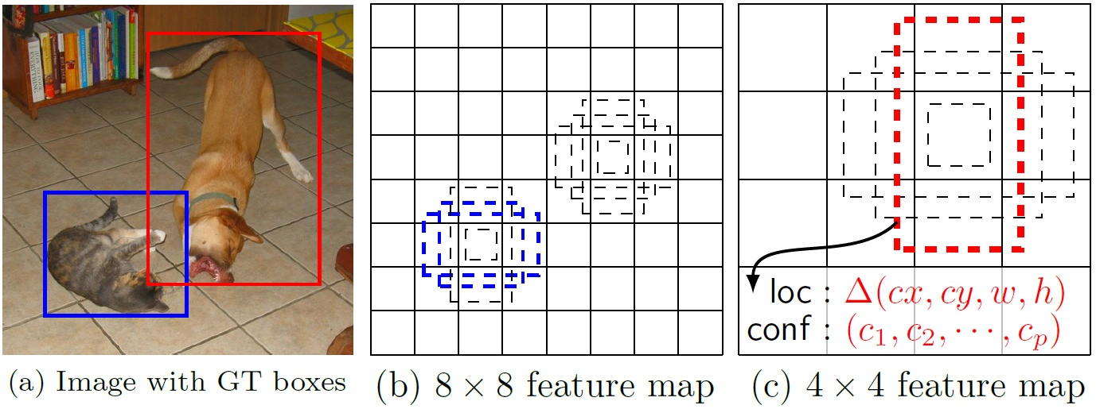
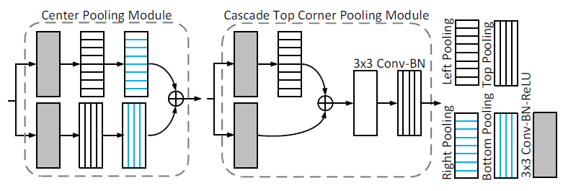
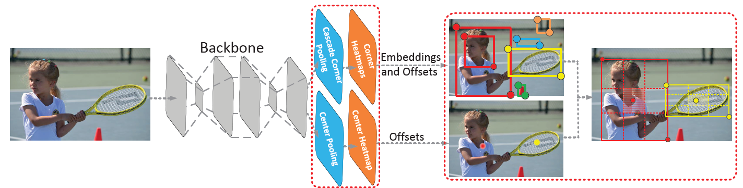
Towards Anchor-Free
Hei Law, Jia, Deng, CornerNet: Detecting Objects as Paired Keypoints, ECCV 2018
Kaiwen Duan, Song Bai, Lingxi Xie, Honggang Qi, Qingming Huang, Qi Tian, CenterNet: Keypoint Triplets for Object Detection，ICCV 2019.

Slide 6
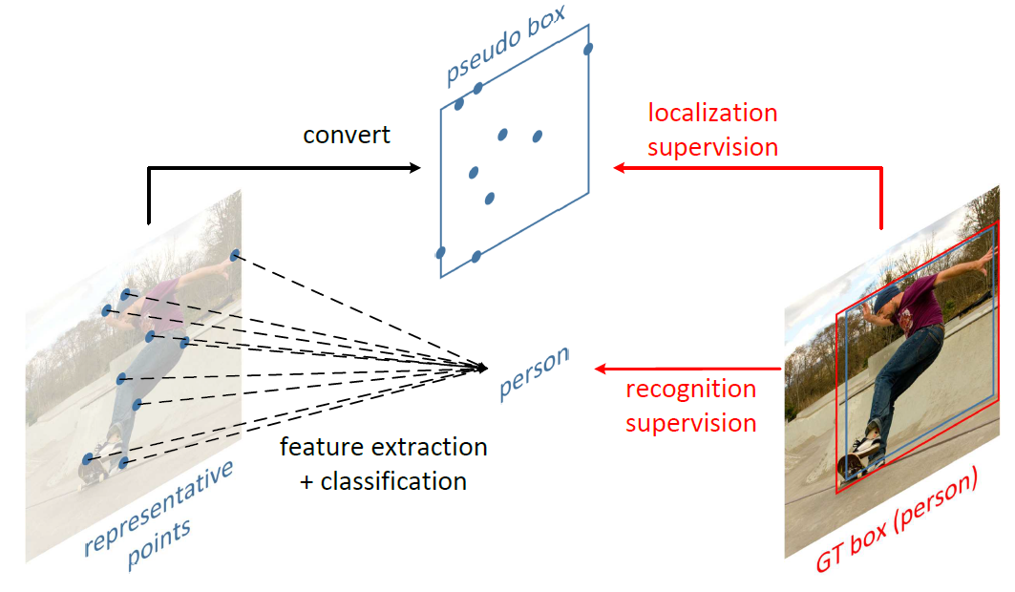
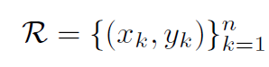
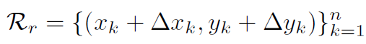
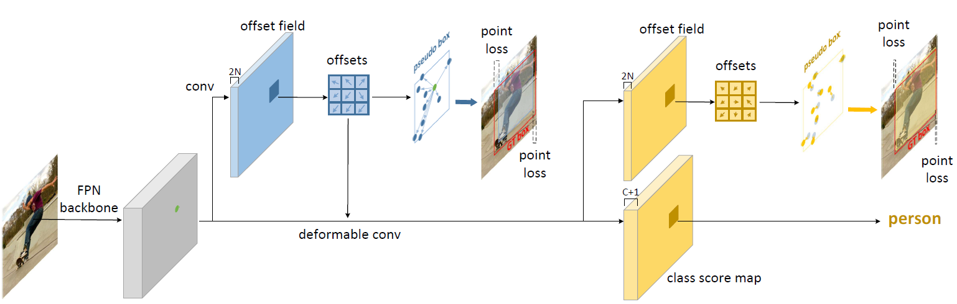
Towards Anchor-Free
Feature Point：
Refinement:
Ze Yang, Shaohui Liu, Han Hu, Liwei Wang, Stephen Lin,
RepPoints: Point Set Representation for Object Detection, ICCV 2019

Slide 7
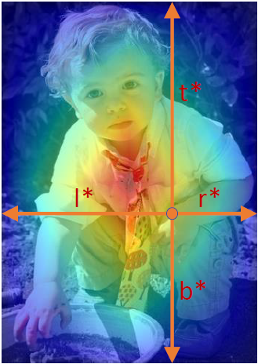
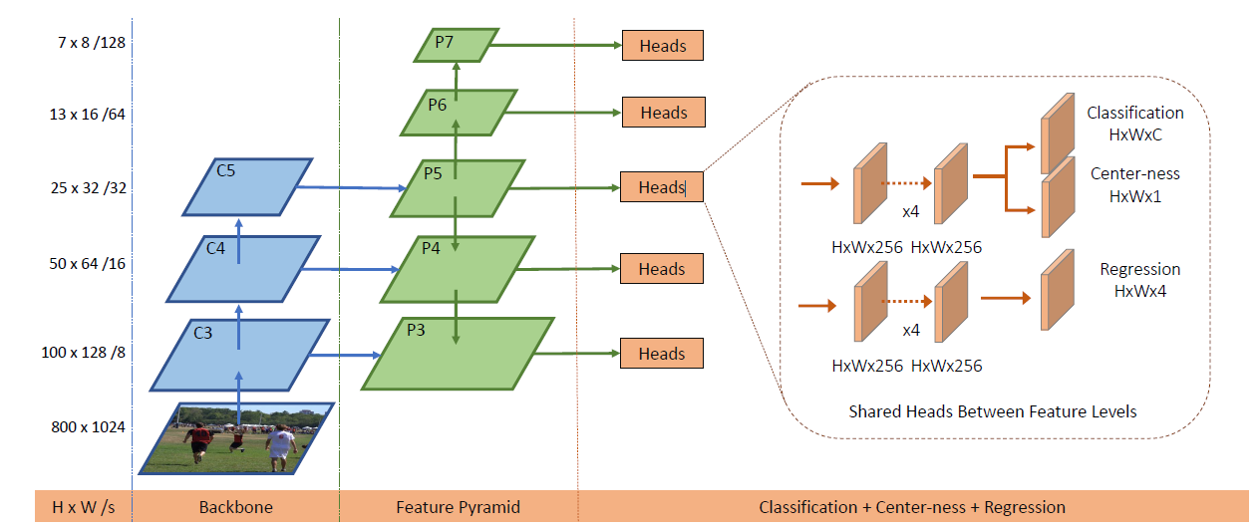
Towards Anchor-Free
Zhi Tian, Chunhua Shen, Hao Chen, Tong He, FCOS: Fully Convolutional One-Stage Object Detection, ICCV 2019

Slide 8
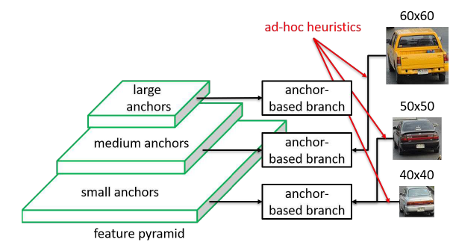
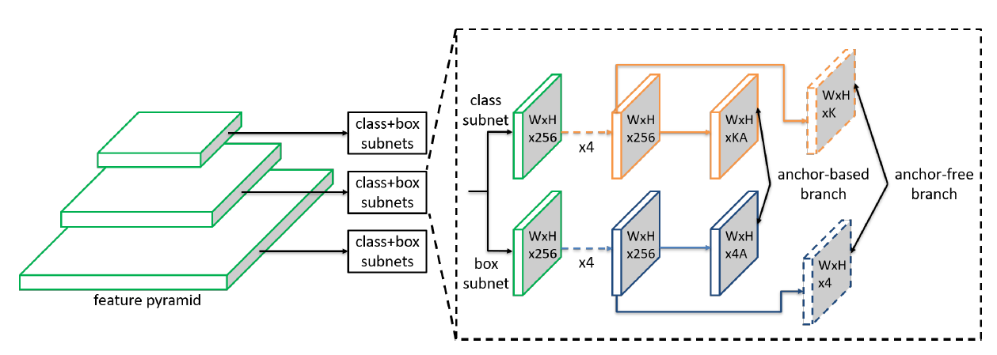
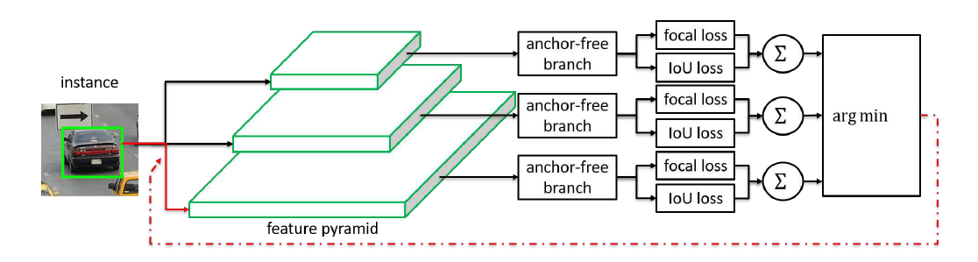
Towards Anchor-Free
Selected feature level in anchor-based branches may not be optimal.
The FSAF module introduces two additional conv layers (dashed feature maps) per pyramid level for feature selection, keeping the architecture fully convolutional.
Chenchen Zhu, Yihui He, Marios Savvides, Feature Selective Anchor-Free Module for Single-Shot Object Detection, CVPR 2019, CMU
Online Feature Selection

Slide 9
Overview
Method
Problem
Data
1. Anchor-Free
2. Learning to Match
3. NAS
4. DERT
1. Efficiency
2. Domain Adaptation
3. Few-shot Detection
1. Long-tailed Distribut.
2. Low-Resolution
3. Dense Objects

Slide 10
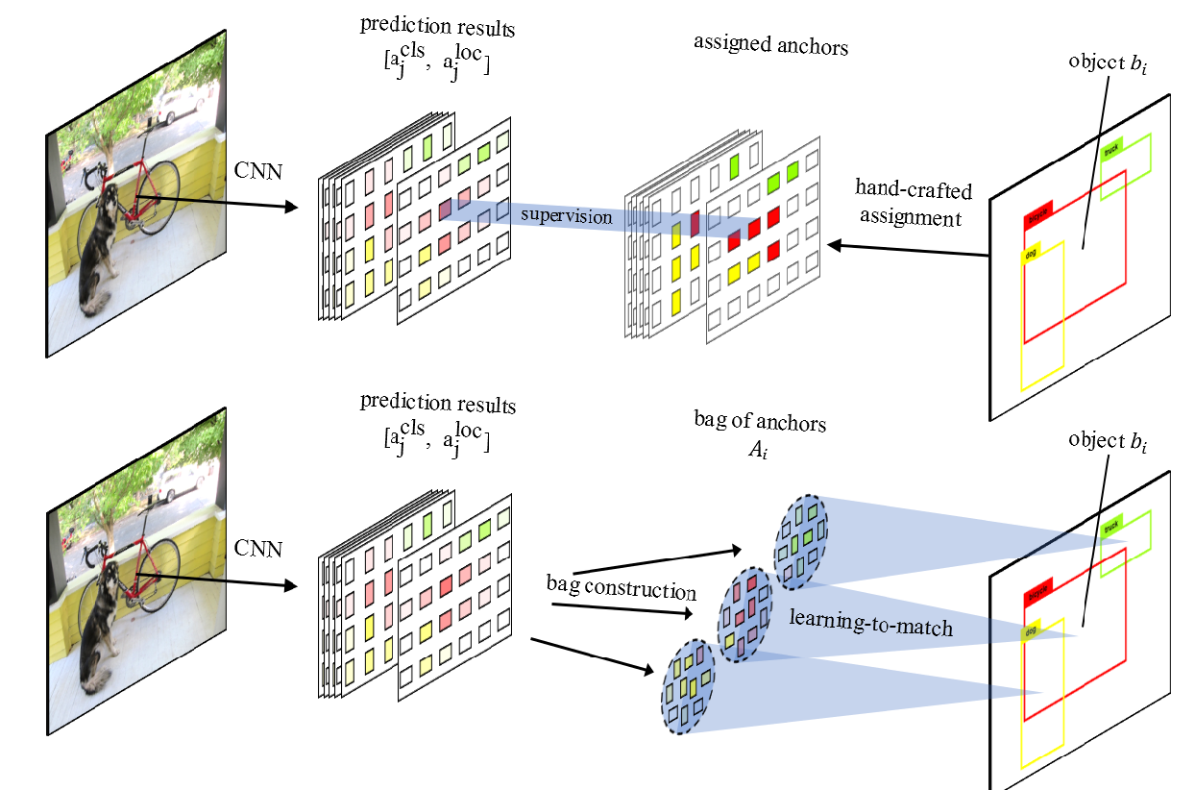
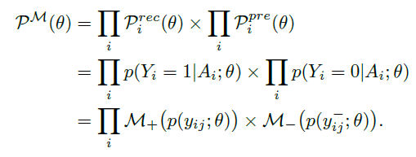
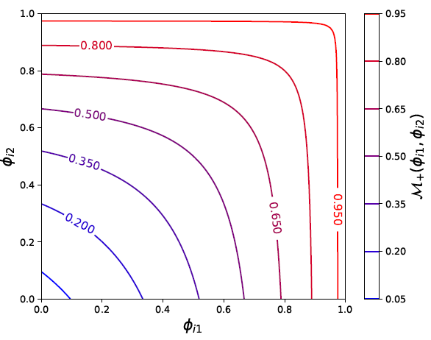
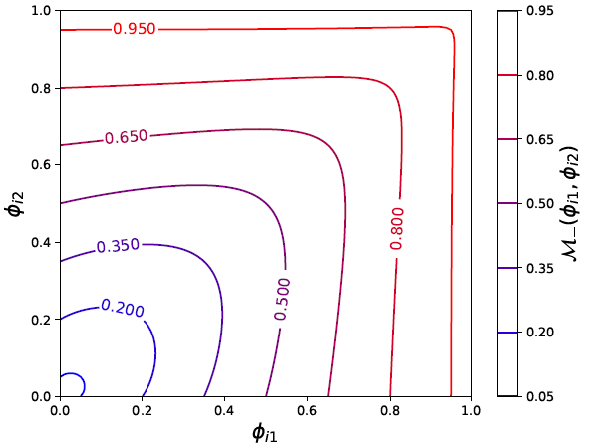
Learning to Match
Learning to Match Anchors/Features
Learning to Match Anchors/Features
Anchor Matching Functions
Xiaosong Zhang, Fang Wan, Chang Liu, Rongrong Ji, Qixiang Ye, FreeAnchor: Learning to Match Anchors for Object Detection, NeurIPS2019

Slide 11
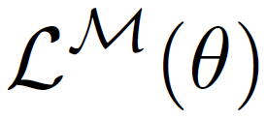
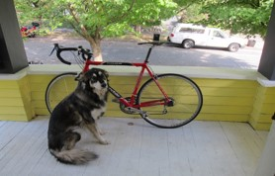
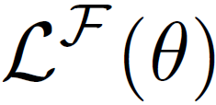
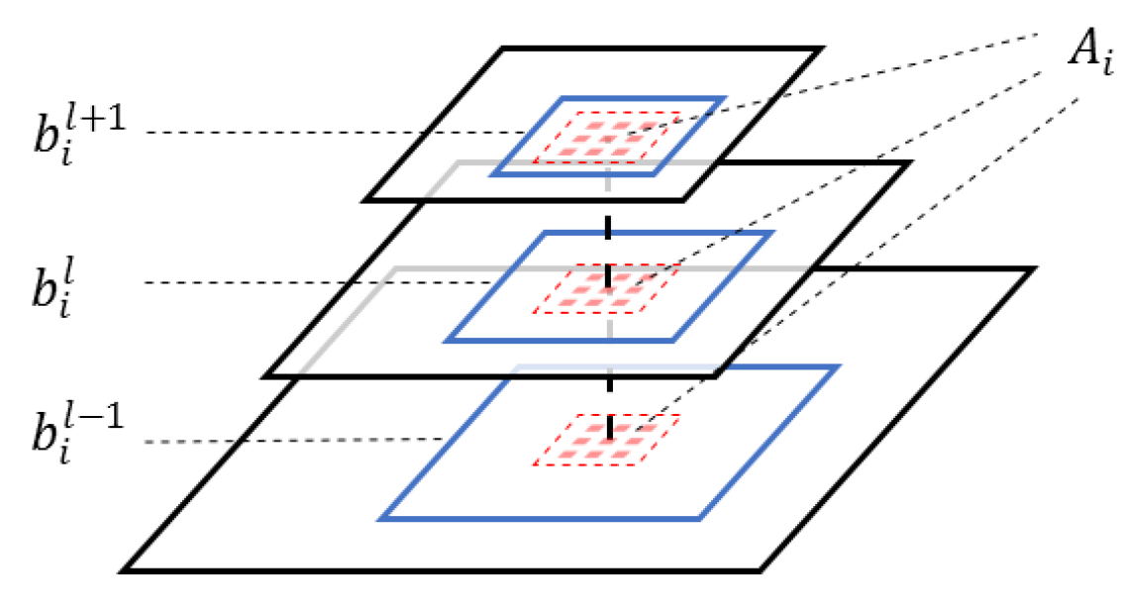
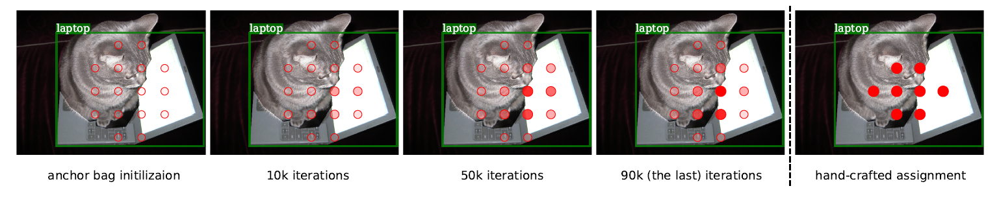
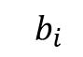
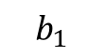



Learning to Match
Backbone
Feature Pyramid
Subnets
Bags
Ground-truth
CNN
Classificatoin & Localization
…
…
…
Classificatoin & Localization
Predictions
…
…
…
Classificatoin & Localization
Background
FreeFeature
Anchor/feature selection during training
Xiaosong Zhang, Fang Wan, Chang Liu, Rongrong Ji, Qixiang Ye, FreeAnchor: Learning to Match Anchors for Object Detection, NeurIPS2019.
$${ b}_{1}$$
$${ A}_{1}$$
$${ b}_{i}$$
$${ A}_{i}$$
$${ A}_{−}$$

Slide 12
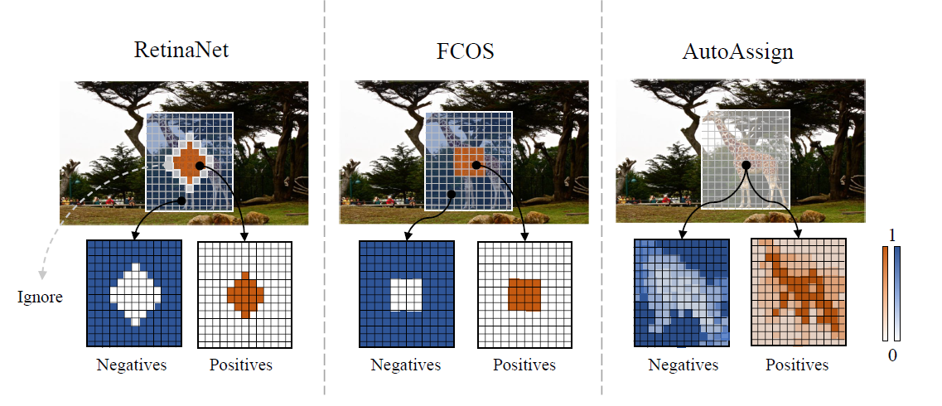
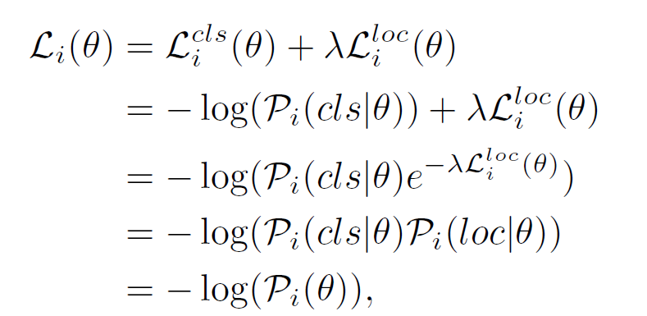
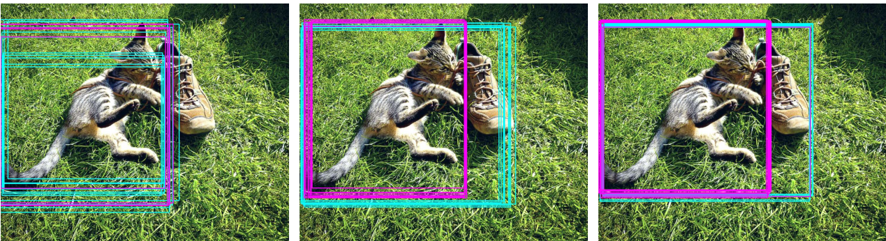
Learning to Match
Benjin Zhu, Jianfeng Wang, Zhengkai Jiang, Fuhang Zong, Songtao Liu, Zeming Li, Jian Sun, AutoAssign: Differentiable Label Assignment for Dense Object Detection, Axiv 2020.

Slide 13
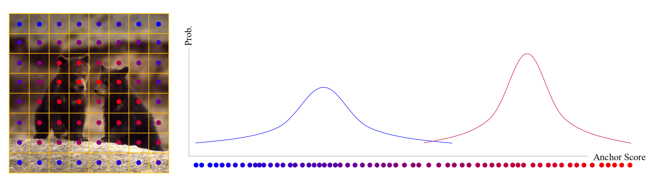
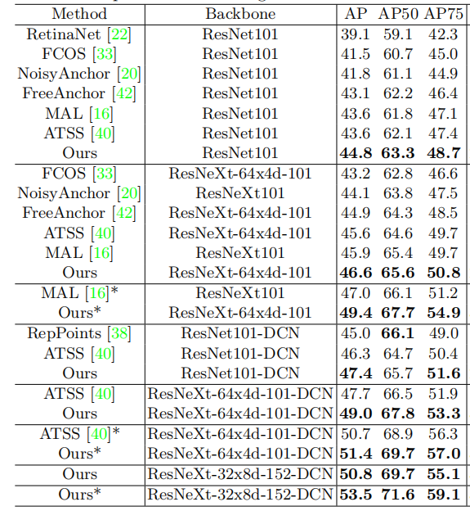
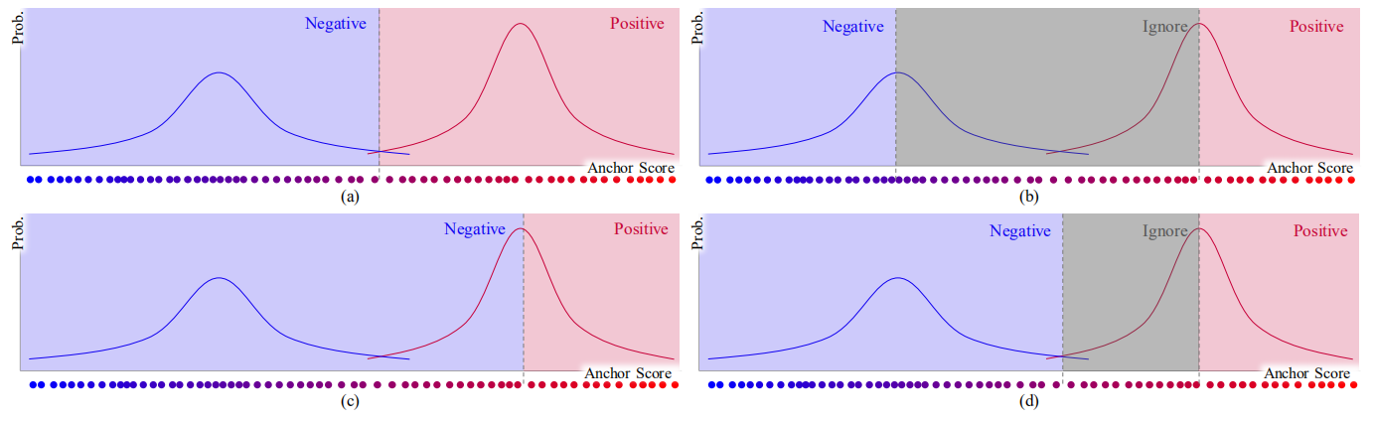
Learning to Match
Kang Kim, Hee Seok Lee, Probabilistic Anchor Assignment with IoU Prediction for Object Detection, ECCV20

Slide 14
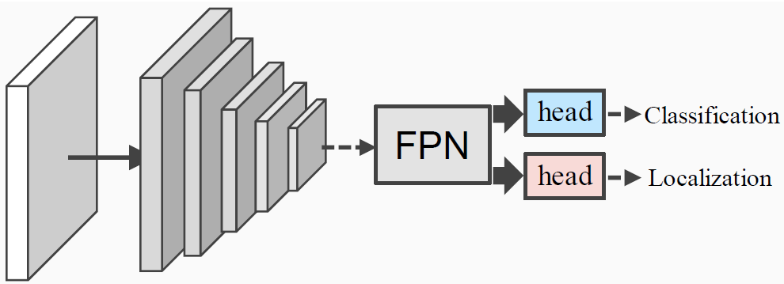
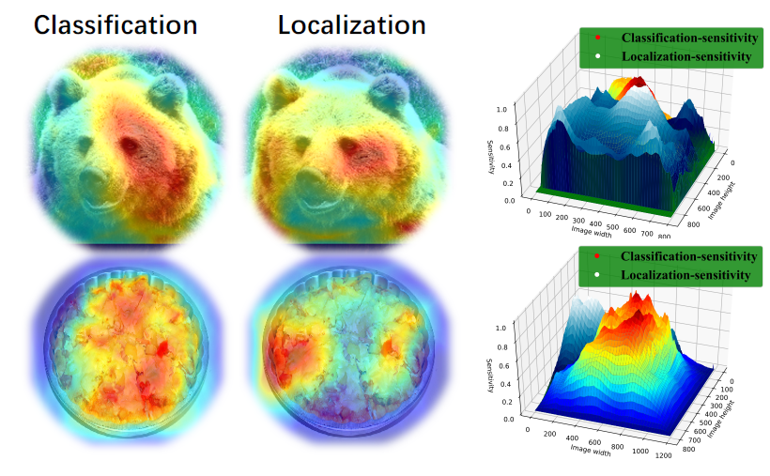
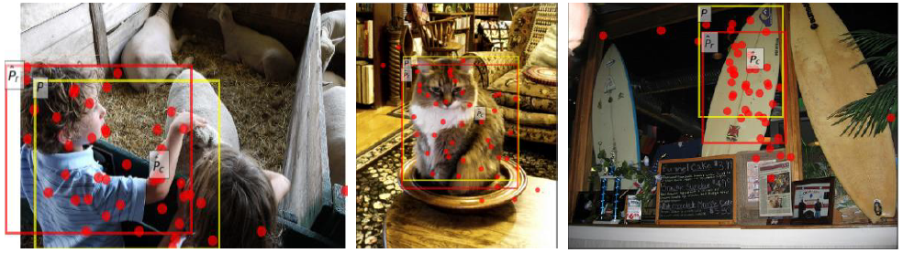
Feature Decoulping
(b) Two-head FPN
(a) Feature decoupling
(c) Detection Results and Selected Features
Guanglu Song, Yu Liu, Xiaogang Wang, Revisiting the Sibling Head in Object Detector, IEEE CVPR 2020

Slide 15
Overview
Method
Problem
Data
1. Anchor-Free
2. Learning to Match
3. NAS
4. DERT
1. Efficiency
2. Domain Adaptation
3. Few-shot Detection
1. Long-tailed Distribut.
2. Low-Resolution
3. Dense Objects

Slide 16
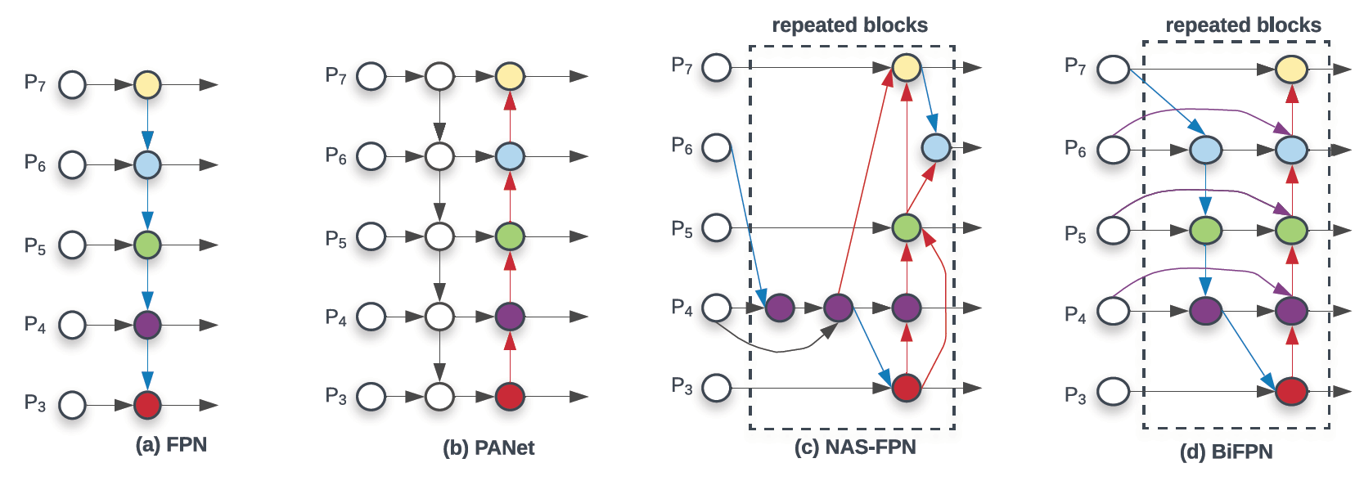
Method-NAS
Mingxing Tan Ruoming Pang Quoc V. Le, EfficientDet: Scalable and Efficient Object Detection, CVPR 2020

Slide 17
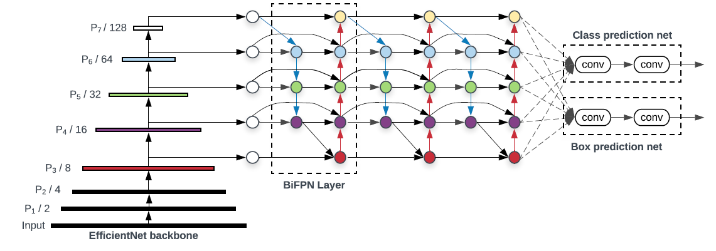
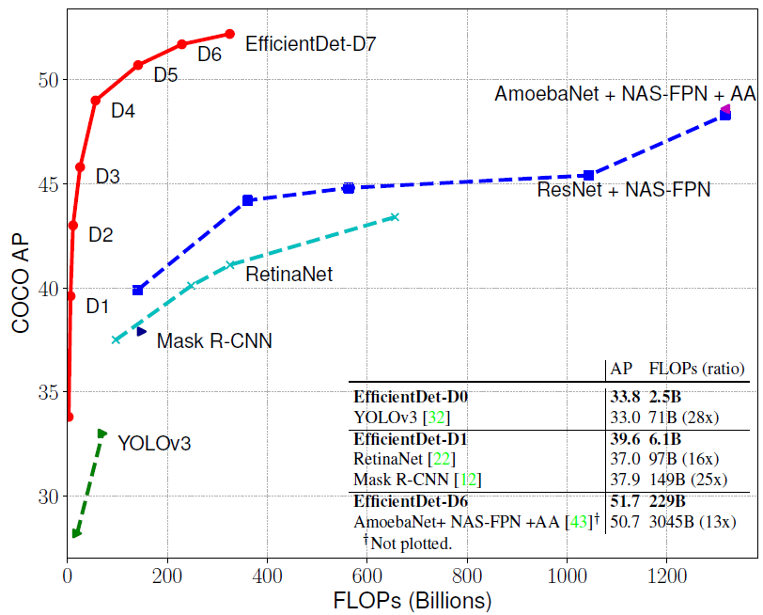
Method-NAS
Mingxing Tan Ruoming Pang Quoc V. Le, EfficientDet: Scalable and Efficient Object Detection, CVPR 2020

Slide 18
Overview
Method
Problem
Data
1. Anchor-Free
2. Learning to Match
3. NAS
4. DERT
1. Efficiency
2. Domain Adaptation
3. Few-shot Detection
1. Long-tailed Distribut.
2. Low-Resolution
3. Dense Objects

Slide 19
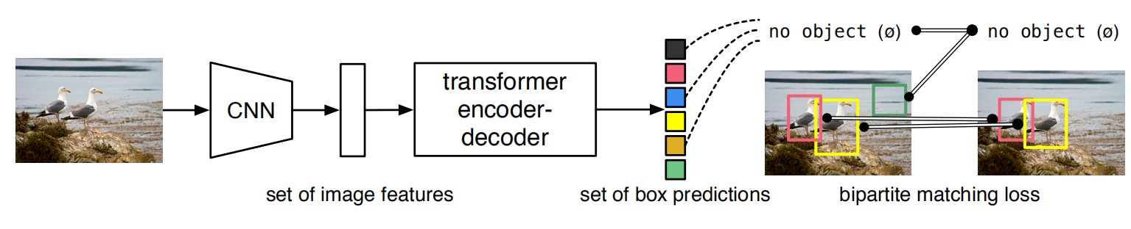
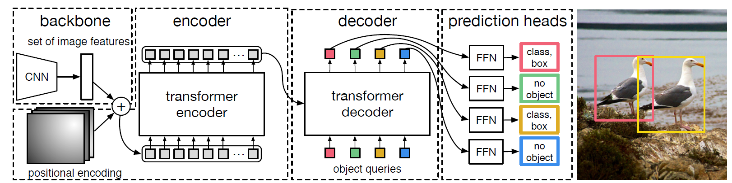
Detection with Transformers
Nicolas Carion, Francisco Massa, Gabriel Synnaeve, Nicolas Usunier, Alexander Kirillov, and Sergey Zagoruyko, End-to-End Object Detection with Transformers, Arxiv:2005.12872v3

Slide 20
Detection with Transformers
NMS
Sliding window classification
Detection Results
DERT ENDs the 20-Years History of Sliding Window Classification +NMS
Nicolas Carion, Francisco Massa, Gabriel Synnaeve, Nicolas Usunier, Alexander Kirillov, and Sergey Zagoruyko, End-to-End Object Detection with Transformers, Arxiv:2005.12872v3

Slide 21
Overview
Method
Problem
Data
1. Anchor-Free
2. Learning to Match
3. NAS
4. DERT
1. Efficiency
2. Domain Adaptation
3. Few-shot Detection
1. Long-tailed Distribut.
2. Low-Resolution
3. Dense Objects

Slide 22
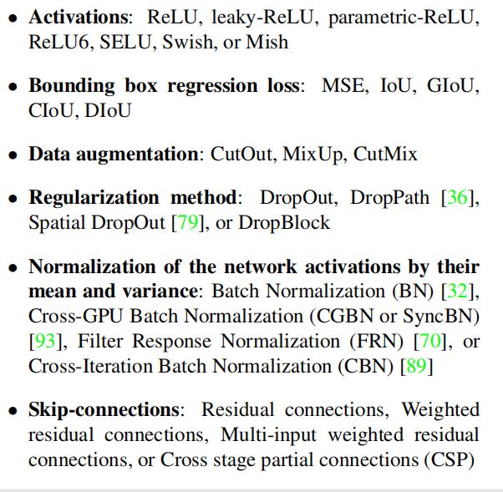
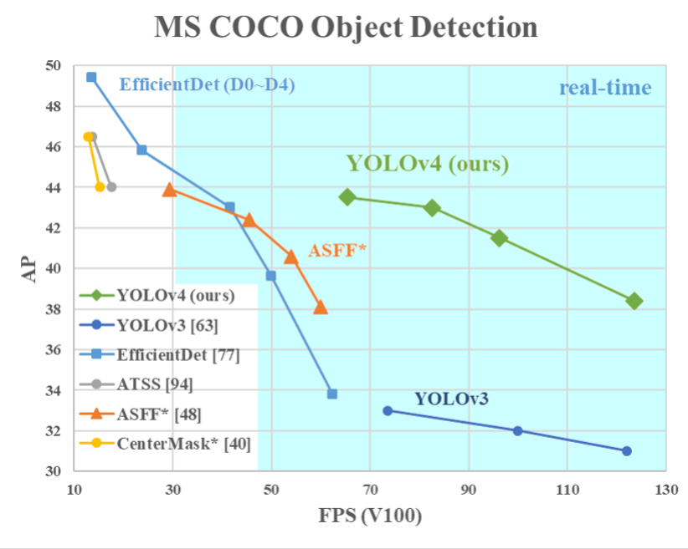
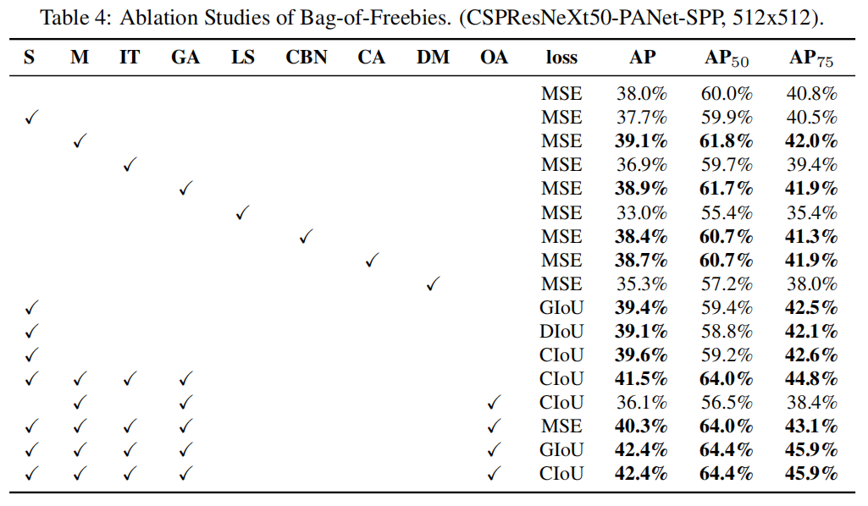
Efficiency-YOLO-V4
Demo
Alexey Bochkovskiy, Chien-Yao Wang, Hong-Yuan Mark Liao: YOLOv4: Optimal Speed and Accuracy of Object Detection. CoRR abs/2004.10934 (2020)

Slide 23
Overview
Method
Problem
Data
1. Anchor-Free
2. Learning to Match
3. NAS
4. DERT
1. Efficiency
2. Domain Adaptation
3. Few-shot Detection
1. Long-tailed Distribut.
2. Low-Resolution
3. Dense Objects

Slide 24
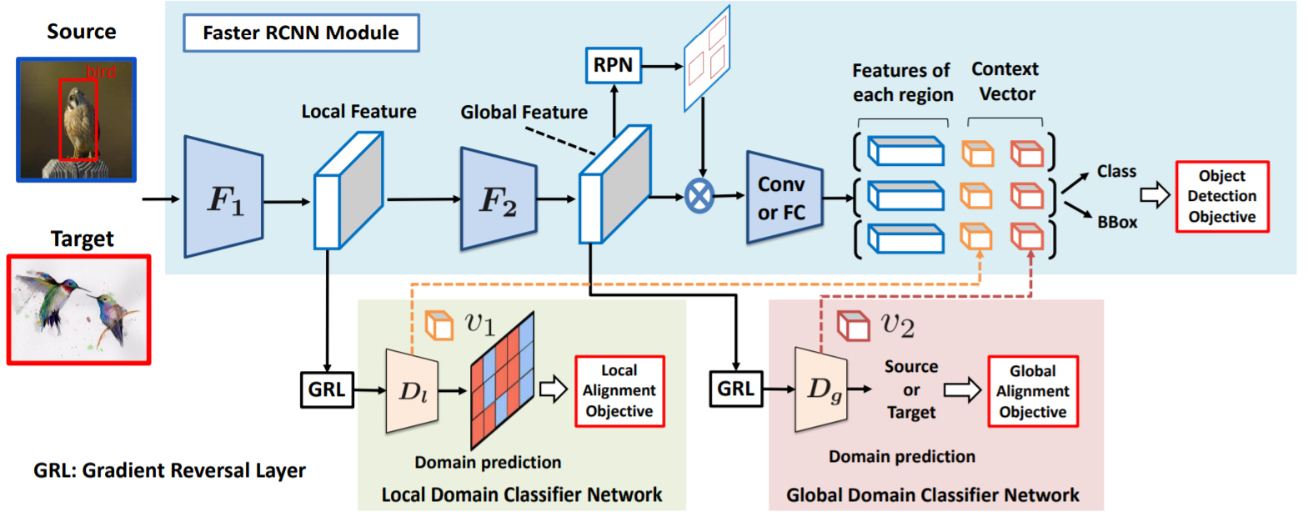
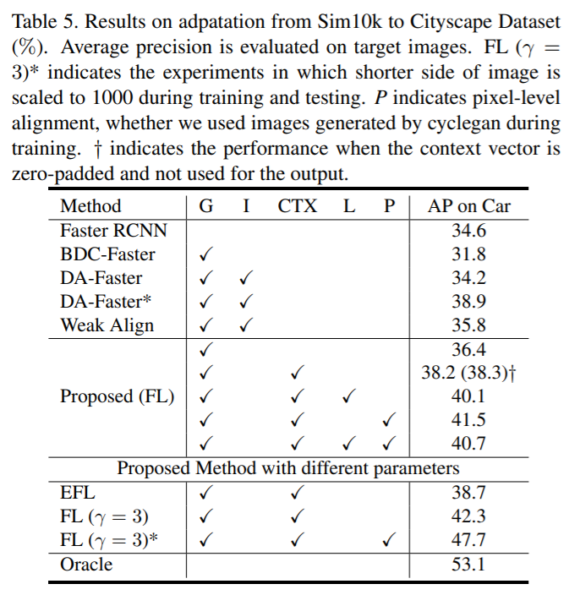
Domain Adaptive Detection
Kuniaki Saito, Yoshitaka Ushiku, Tatsuya Harada, Kate Saenko:
Strong-Weak Distribution Alignment for Adaptive Object Detection. CVPR 2019: 6956-6965

Slide 25
Overview
Method
Problem
Data
1. Anchor-Free
2. Learning to Match
3. NAS
4. DERT
1. Efficiency
2. Domain Adaptation
3. Few-shot Detection
1. Long-tailed Distribut.
2. Low-Resolution
3. Dense Objects

Slide 26
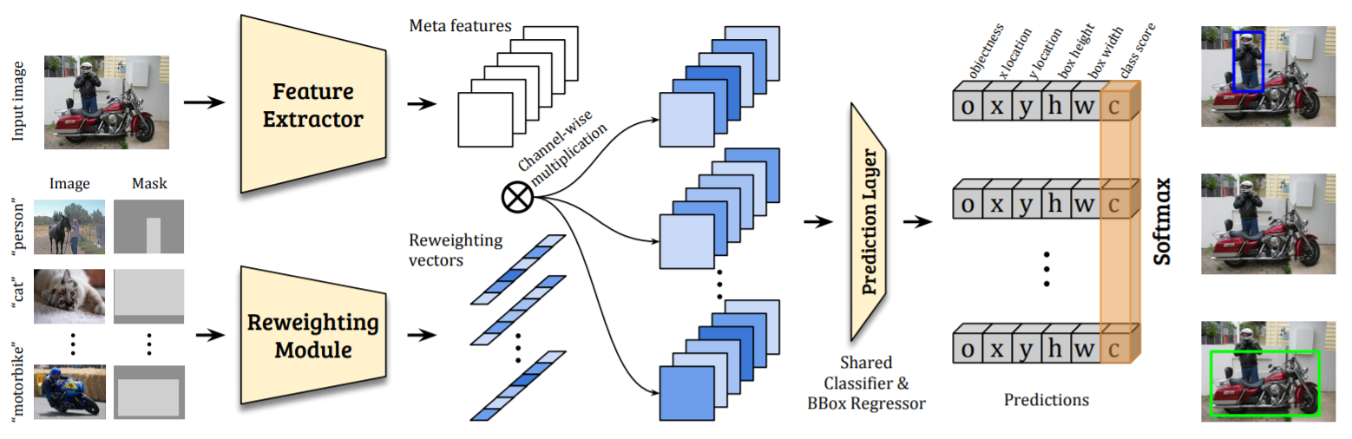
Few-shot Object Detection
Bingyi Kang, Zhuang Liu, Xin Wang, Fisher Yu, Jiashi Feng, Trevor Darrell: Few-Shot Object Detection via Feature Reweighting. ICCV 2019: 8419-8428

Slide 27
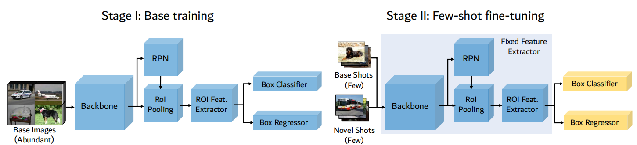
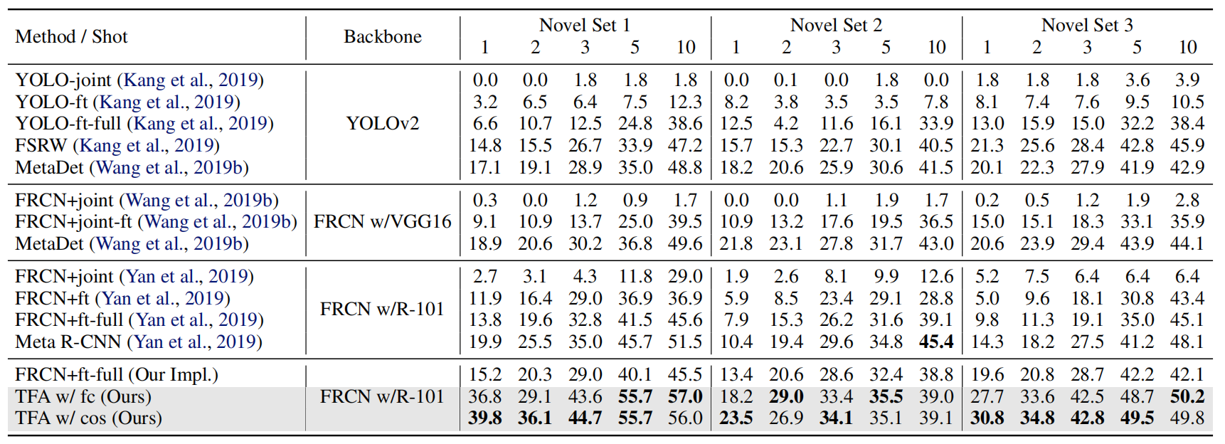
Few-shot Object Detection
Xin Wang, Trevor Darrell, Fisher Yu, Frustratingly Simple Few-Shot Object Detection, ICML 2020.

Slide 28
Overview
Method
Problem
Data
1. Anchor-Free
2. Learning to Match
3. NAS
4. DERT
1. Efficiency
2. Domain Adaptation
3. Few-shot Detection
1. Long-tailed Distribut.
2. Low-Resolution
3. Dense Objects

Slide 29
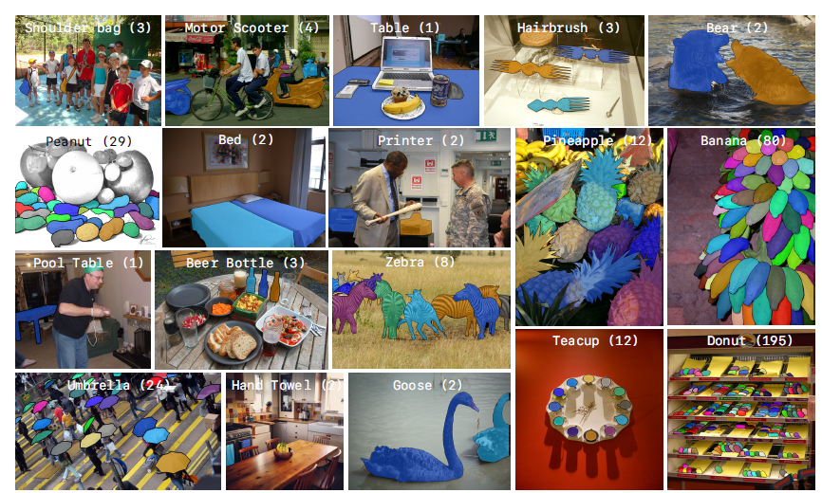
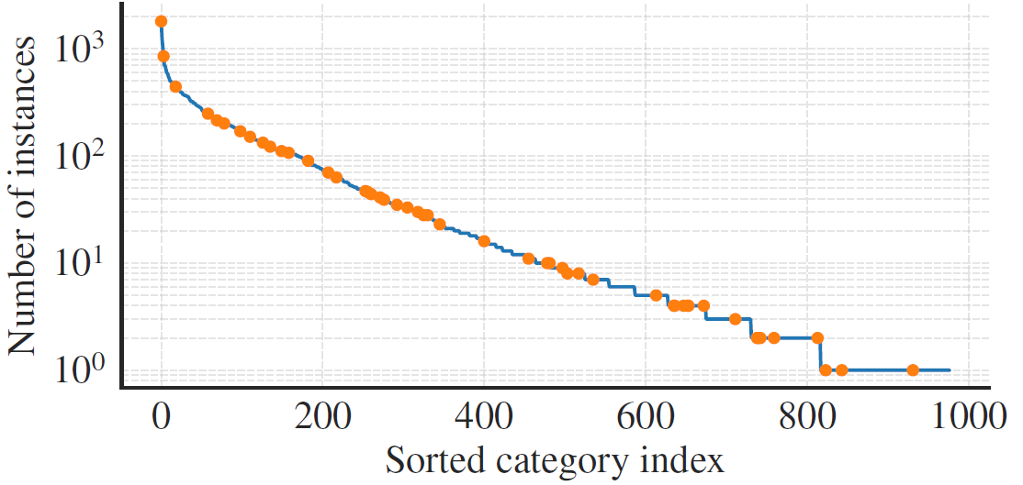
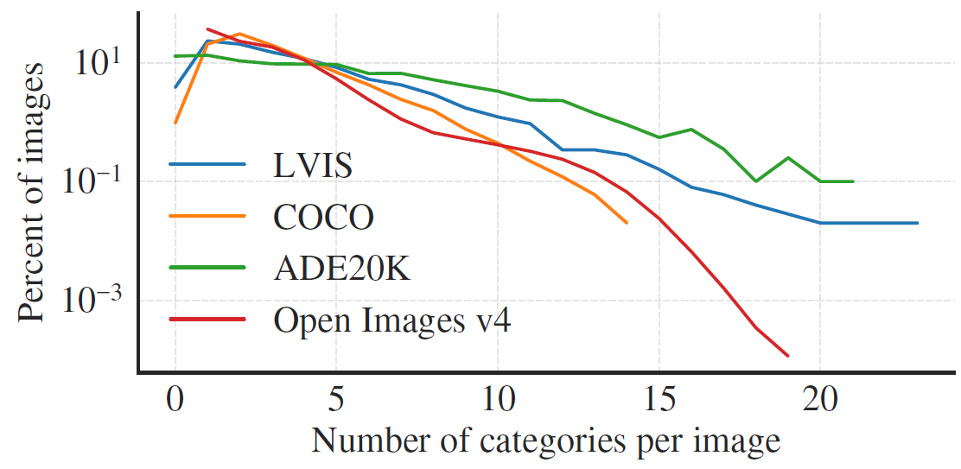
Long-tailed Distribution
Agrim Gupta Piotr Doll´ar Ross Girshick, LVIS: A Dataset for Large Vocabulary Instance Segmentation, CVPR 2020

Slide 30
Overview
Method
Problem
Data
1. Anchor-Free
2. Learning to Match
3. NAS
4. DERT
1. Efficiency
2. Domain Adaptation
3. Few-shot Detection
1. Long-tailed Distribut.
2. Low-Resolution
3. Dense Objects

Slide 31
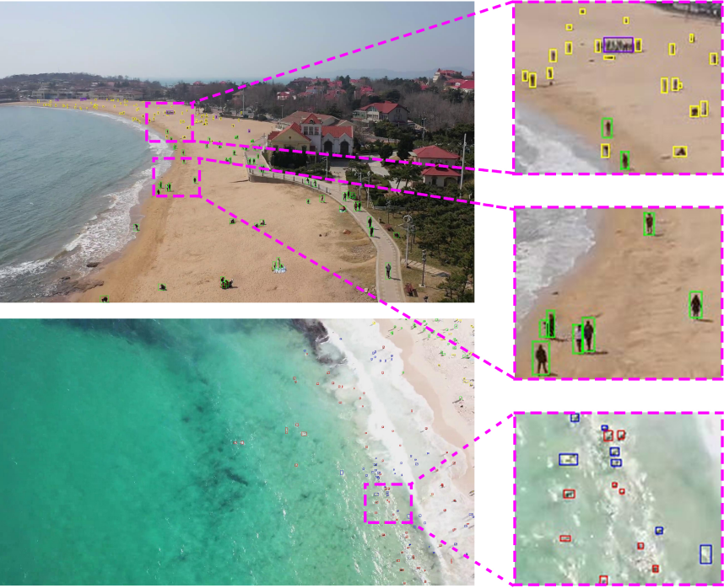
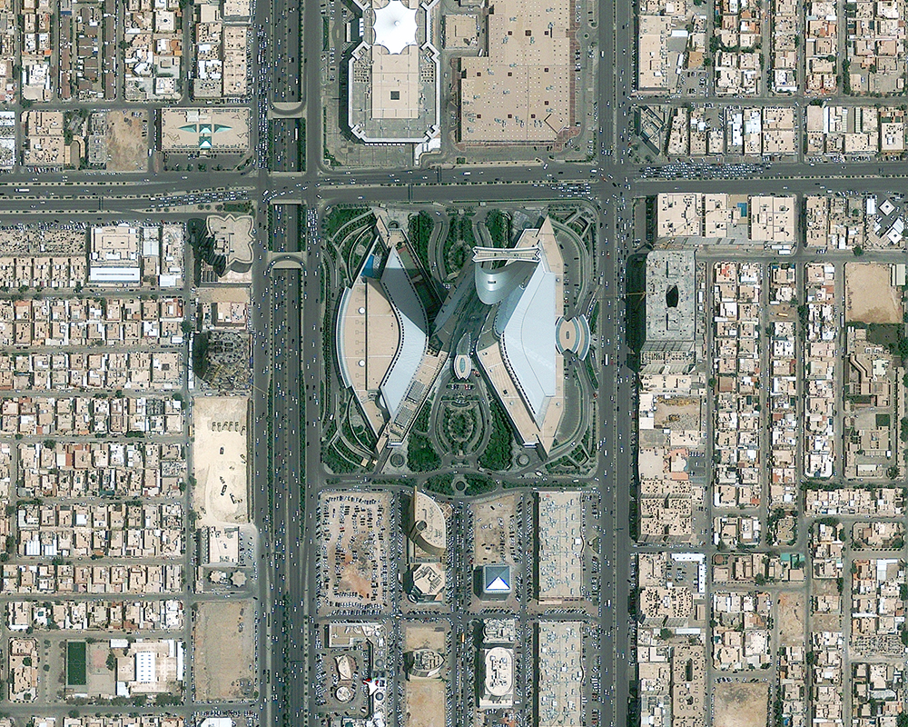
Low-resolution Objects
Xuehui Yu, Yuqi Gong, Nan Jiang, Zhenjun Han，Scale Match for Tiny Person Detection， WACV2020

Slide 32
Overview
Method
Problem
Data
1. Anchor-Free
2. Learning to Match
3. NAS
4. DERT
1. Efficiency
2. Domain Adaptation
3. Few-shot Detection
1. Long-tailed Distribut.
2. Low-Resolution
3. Dense Objects

Slide 33

Dense Objects
Eran Goldman, Roei Herzig, Aviv Eisenschtat, Jacob Goldberger, and Tal Hassner. Precise Detection in Densely Packed Scenes, CVPR 2019
Xingjia Pan，Changsheng Xu: Dynamic Refinement Network for Oriented and Densely Packed Object Detection, CVPR 2020

Slide 34

Dense Objects
Wang, Qi and Gao, Junyu and Lin, Wei and Li, Xuelong, NWPU-Crowd: A Large-Scale Benchmark for Crowd Counting and Localization, PAMI2020.

Slide 35
In the Future
Method
Problem
Data
1. Anchor-Free
2. Learning to Match
3. NAS
4. DERT
1. Efficiency
2. Domain Adaptation
3. Few-shot Detection
1. Long-tailed Distribut.
2. Low-Resolution
3. Dense Objects

Slide 36
Thanks
www.ucassdl.cn
qxye@ucas.ac.cn
people.ucas.ac.cn/~qxye

